Slide 1
Lesson 4
CSS Layout and Positioning

Slide 2
Agenda
Objective: Learn how to use CSS for layout and positioning of elements.
Topics Covered:
The box model: margins, borders, padding, and content
CSS positioning: static, relative, absolute, fixed
Using Flexbox for layout
Media Queries
Activity

Slide 3
The Box Model

Slide 4
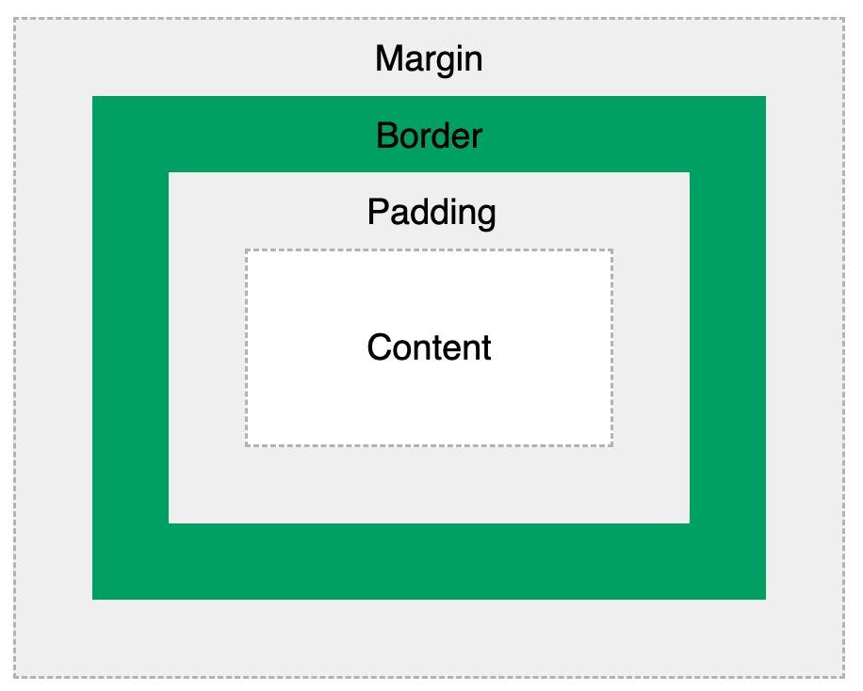
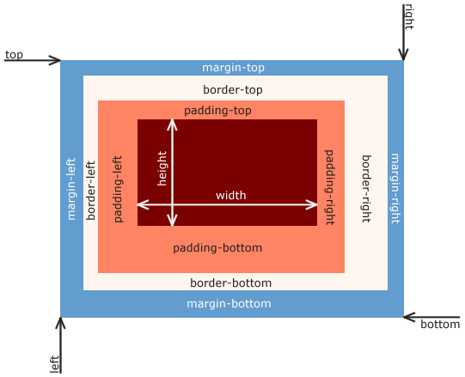
Box Model
a box that wraps around every HTML element

Slide 5
Box Model Parts
Content - The content of the box, where text and images appear
Padding - Clears an area around the content. The padding is transparent
Border - A border that goes around the padding and content
Margin - Clears an area outside the border. The margin is transparent
Allows us to add a border around elements
Define space between elements.

Slide 6
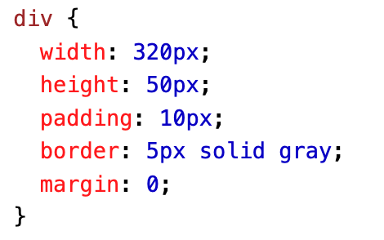
Width and Height of an Element
When you set the width and height properties of an element with CSS, you just set the width and height of the content area. To calculate the total width and height of an element, you must also include the padding and borders.
Total element width = width + left padding + right padding + left border + right border
Total element height = height + top padding + bottom padding + top border + bottom border
Total width and height of <div>?

Slide 7
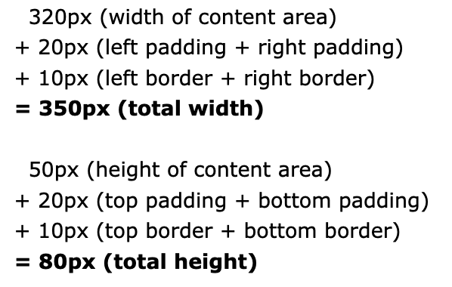
Solution

Slide 8
Quick Exercise
Copy HTML
<!DOCTYPE html>
<html>
<head>
<title>Box Model Exercise</title>
<link rel="stylesheet" type="text/css" href="style.css">
</head>
<body>
<div class="box">This is a box!</div>
</body>
</html>
Instructions (CSS)
Add padding of 20px.
Add a border of 5px solid black.
Add a margin of 15px.
Set the background color to lightblue.

Slide 9
Solution + Discussion Questions
.box {
padding: 20px;
border: 5px solid black;
margin: 15px;
background-color: lightblue;
}
How does changing the padding value affect the space inside the box?
What happens when you increase or decrease the border width?
How does adjusting the margin affect the space around the box?

